Slide 1
Revision, Editing and
Proofreading

Slide 2
Revision
Step One: Admit you have a problem …
Everyone needs to revise!
Revision is considering the overall structure of your paper:
Are you making all the points you want to make?
Do you need to add or take away certain details?
Are you providing all the relevant information?
Is your argument clear?
Do you present information in a logical order?

Slide 3
Revision
This is where you have to be ruthless with your own work!
You must be willing to get rid of what doesn’t work.
To do this, you must accept that your paper is not perfect!
There is no such thing as a perfect essay!

Slide 4
Editing
Looks at how you are presenting information.
Are you using the appropriate tone?
Are you using one kind of sentence or are you using several?
Do you know the meanings of all the words you have used?
No, really, you should probably look some of them up.

Slide 5
Proofreading
Looks at the basics: spelling and grammar.
Have you spelled everything correctly?
DO NOT TRUST SPELLCHECK!
Is your writing grammatically correct?
Are you maintaining a formal style throughout? (no first or second person)

Slide 6
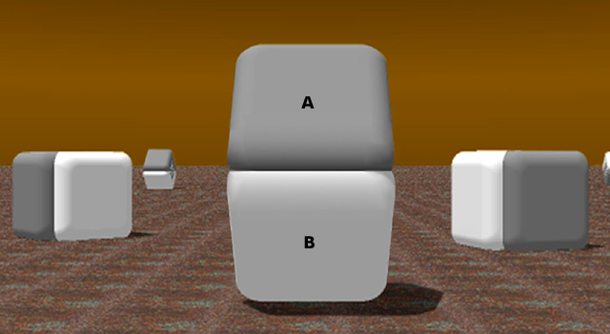
Are the Squares the Same Colour?

Slide 7
Sometimes Your Brain is Your Enemy!
Your brain can play tricks on you!
Sometimes it will show you what it expects to see, not what is actually there.
This can make finding mistakes in your essay very difficult!

Slide 8
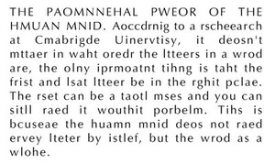
Can You Read This?

Slide 9
Know Your Homonyms
Their isn’t anyone to meat there train.
Correct: There isn’t anyone to meet their train.
It is a mater of principal.
Correct: It is a matter of principle.

Slide 10
Tips and Tricks
Take a break from your paper.
Print off a hard copy and write on it.
Read your paper backwards!
Get someone else to read it.
Learn from your mistakes!
If you aren’t sure, look it up!
Don’t take it personally.

